Slide 1

Online food order system

Slide 2

ONLINE FOOD ORDER SYSTEM
A PROJECT REPORT
In partial fulfilment of the requirements for the award of the degree
BACHELOR OF COMPUTER APPLICATION
Silda Chandra sekhar college
Submitted By
Name of Students : ABHIJIT DUTTA
SOBHANJAN SAHU
DEBANGSHU RANA
UTSAV BHATTACHARYA

Slide 3
Contents
Introduction
Project Specification
Brief overview of the Technology
Data Flow Diagram (DFD)
ER Diagram
Screen Layout
Future Scope
Conclusion
Bibliography

Slide 4
Introduction
Relevance of the Topic
The project is very much relevant in today’s world. Customers can very easily order vegetable and fruit through the web portal.
Problem Definition
The project vegetable &Fruit Ordering System is surely going to make ordering of vegetable a lot easier. Users can now order Vegetable and Fruit from the comforts of their home.

Slide 5
Project Objective To provide online ordering facilities Support services in an integrated fashion so as to provide a simple and hassle free ordering platform. The system interacts to the users (customer, admin) by means of some front-end form. To enter the system a login form will appear where email and Password for both Admins and for the Customers will have to be entered to log into the system and then this will check the Type of that user. According to type the System is loaded. After signup, customers enters into their profile. Customer can check the Vegetable & Fruit menu and order it. After signup, admin can enter into its profile. Admin can view the Vegetable and Fruits, Order List and Store List. Admin can also update/modify/add the details of Vegetable and Store. New users must have to register before login. Every stage data is stored in the database. This is why the system is very easy to use and every user can accept the system by thinking its utility in present and by applying the idea of Prototyping Model the system can be developed with more features in future.

Slide 6
Project Specification
Project Title : Online Food Order System
Institution : Silda Chandra Sekhar College
Front End Tools : HTML, CSS, JavaScript
Back End Tools : PHP(lang), MySQL server
Web Server : XAMPP
Web Browser : Chrome
IDE : VS code
Hardware : 64-bit processor, 2.30 GHz, 4 GB RAM

Slide 7
Brief overview of the Technology
Front end: HTML, CSS, JavaScript
HTML: HTML is used to create and save web document. E.g. Notepad/Notepad++
CSS : (Cascading Style Sheets) Create attractive Layout
JavaScript: it is a programming language, commonly use with web browsers.
Back end: PHP, My SQL
PHP: Hypertext Preprocessor (PHP) is a technology that allows software developers to create dynamically generated web pages, in HTML, XML, or other document types, as per client request. PHP is open source software.
My SQL:- My SQL is a database, widely used for accessing querying,
updating, and managing data in databases

Slide 8
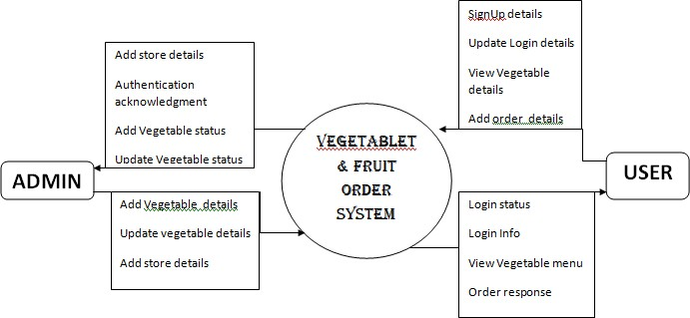
Data Flow Diagram :
Figure 1: DFD-Level

Slide 9
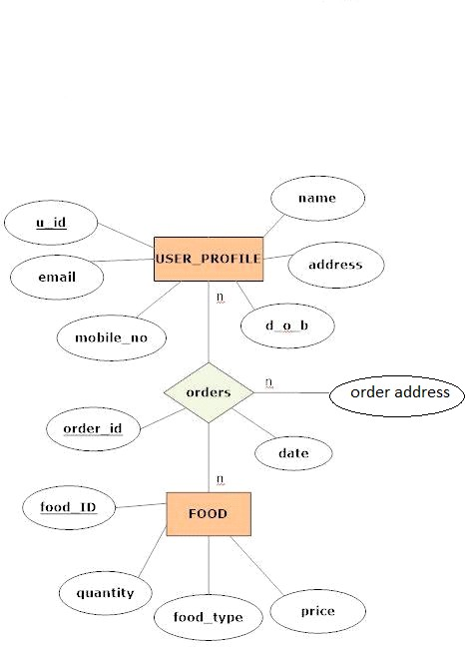
ER Diagram:

Slide 10
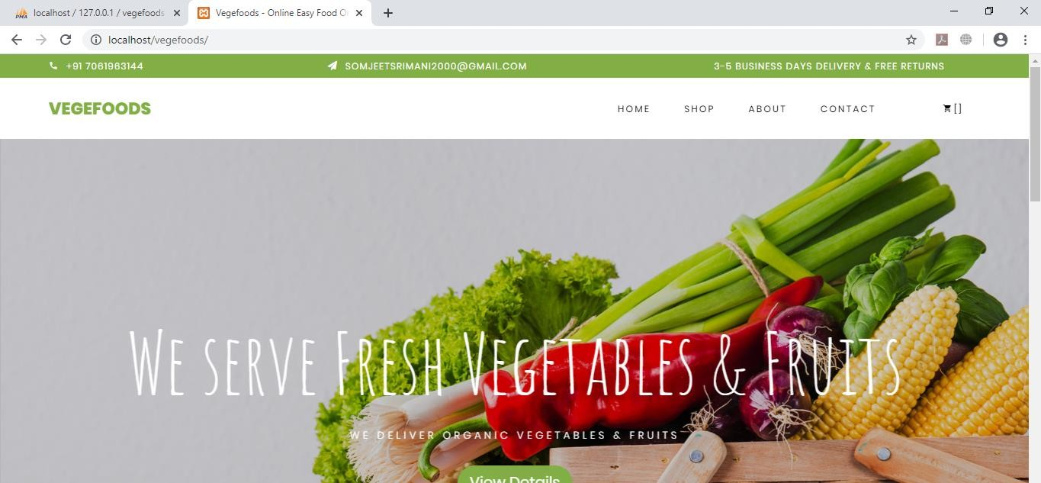
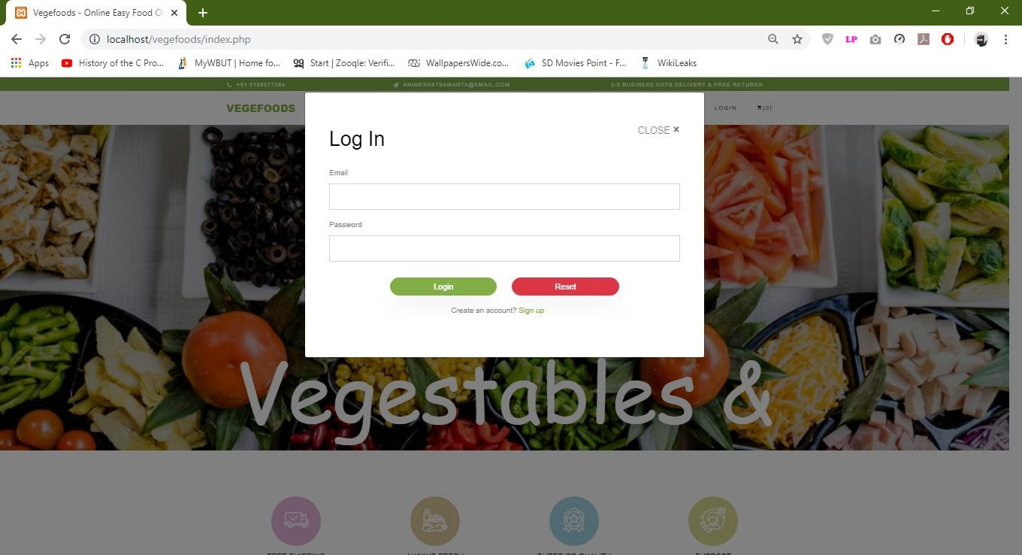
Screen Layout
Home Page :-
Links and Web Pages:
User Login Page:-

Slide 11
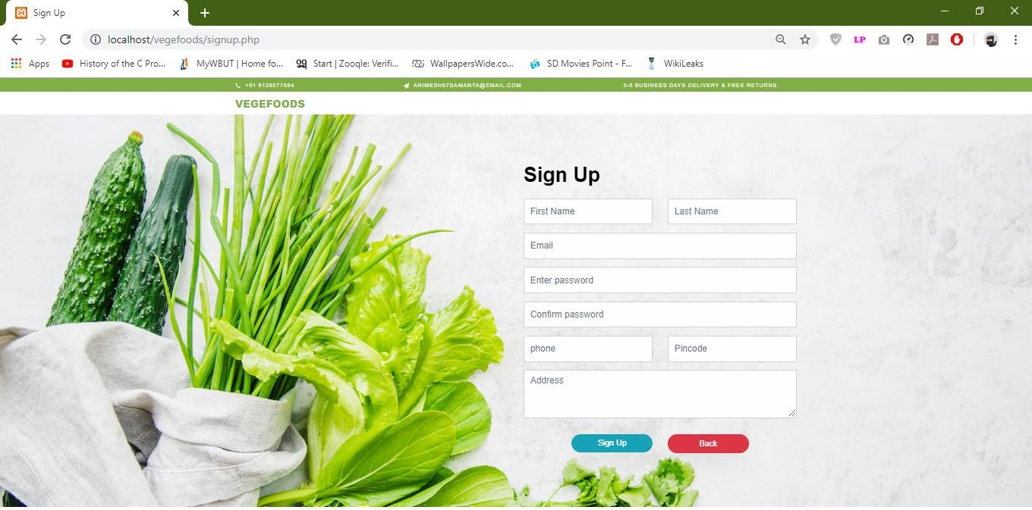
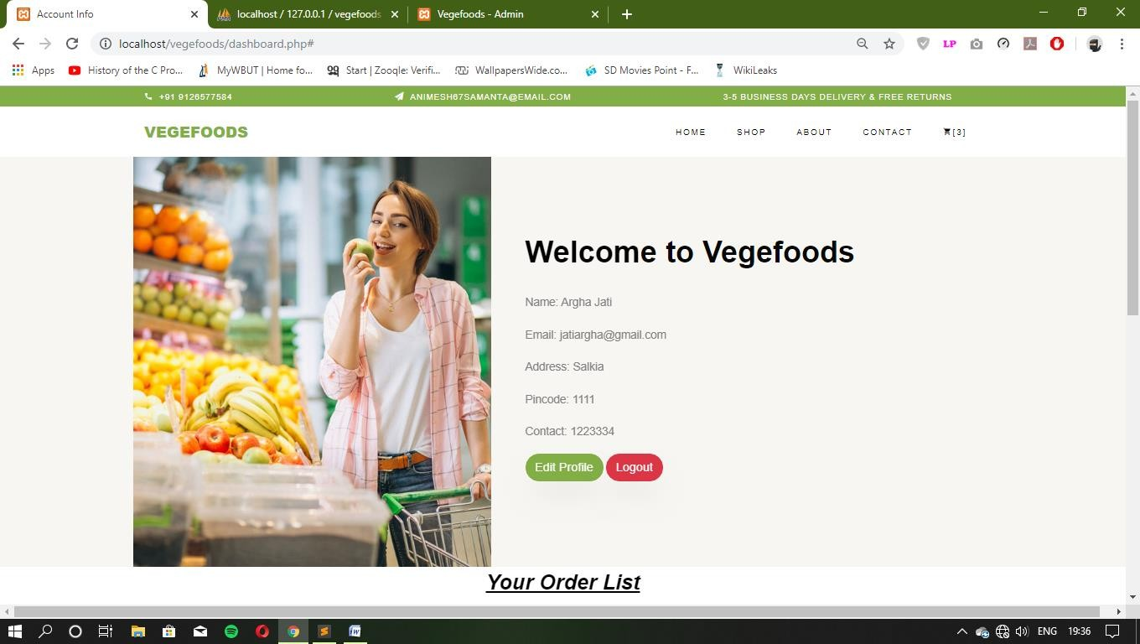
User Sing up page:
User dashboard page :

Slide 12
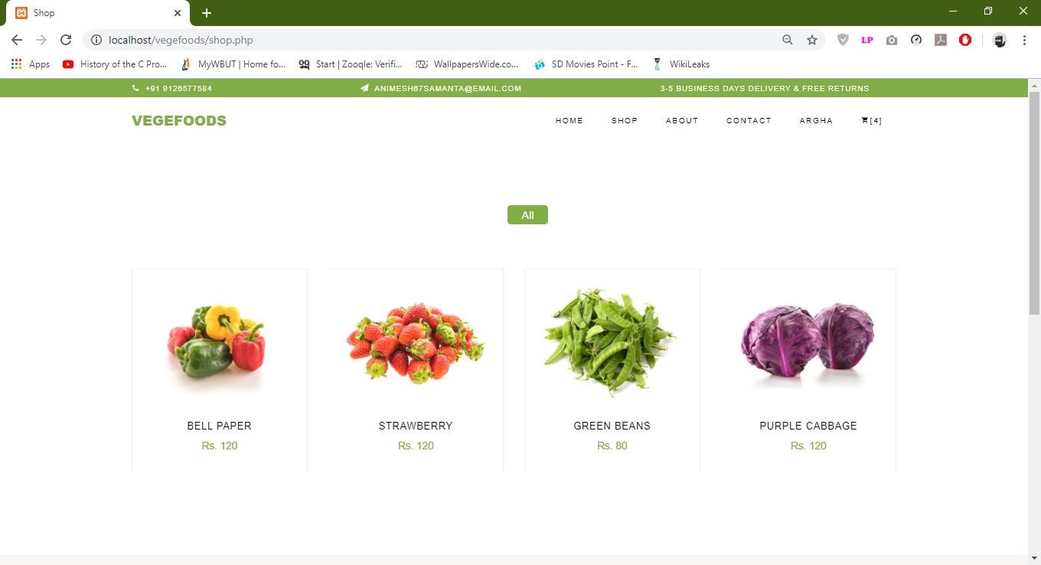
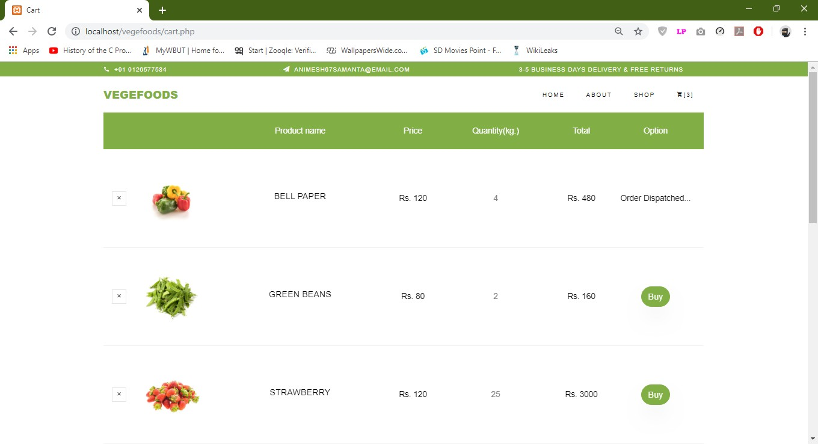
Order menu page:
User cart & orders page:

Slide 13
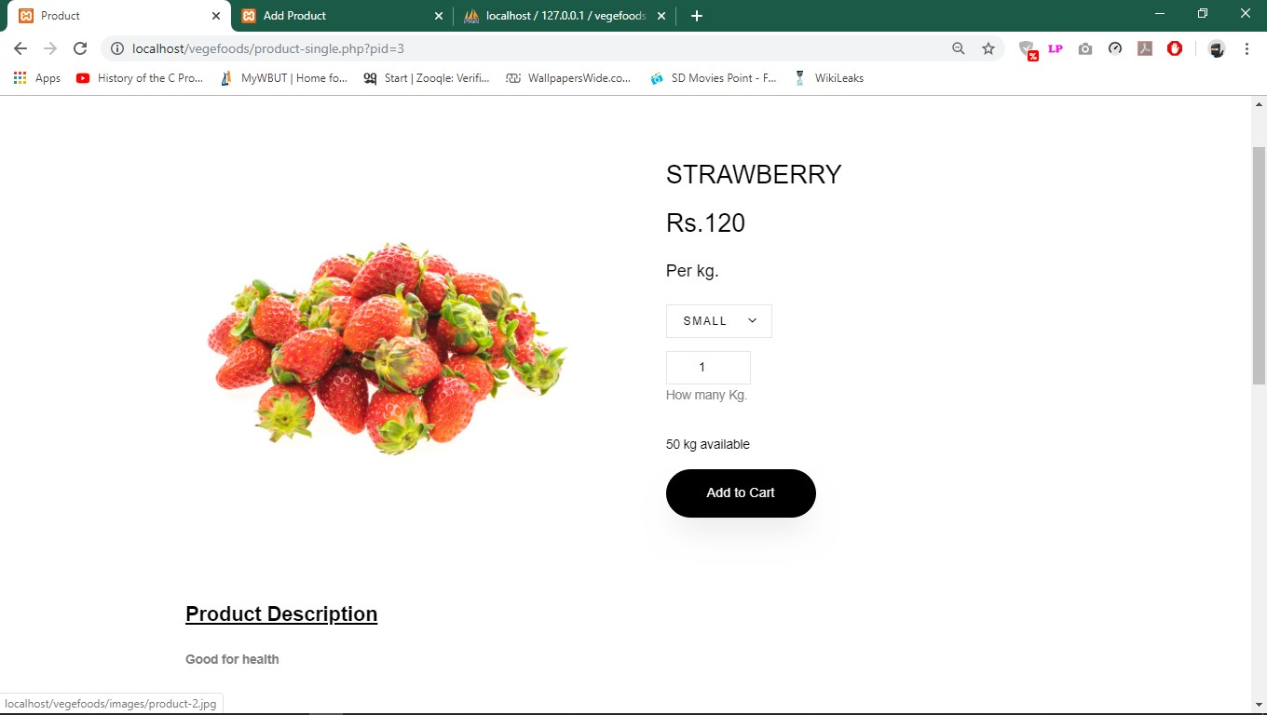
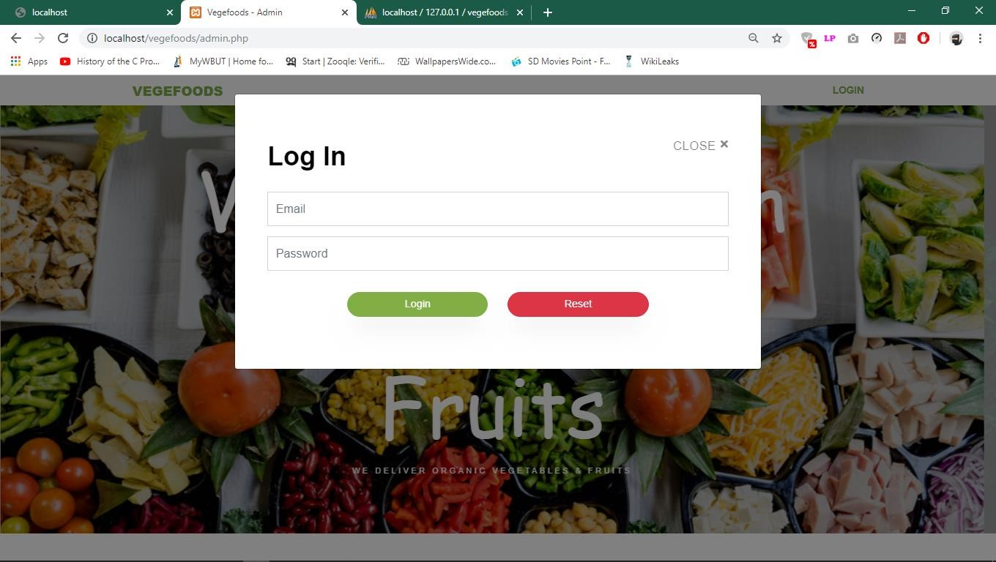
Make order Page:
Admin login page:

Slide 14
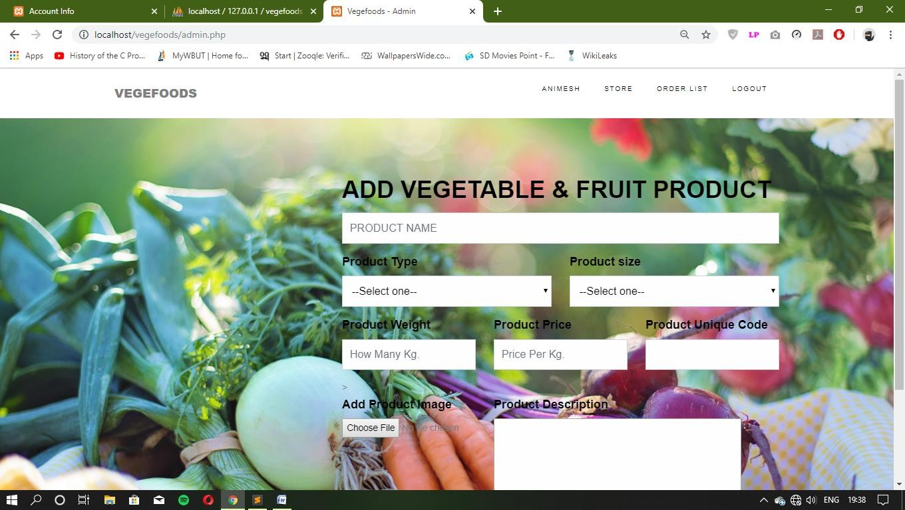
Admin add Vegetable page:

Slide 15
Future scope and further enhancement of the Project:
Since this project has been done by using HTML,sublime.; using XAMPPserver, therefore this project can be further enhanced using more advanced PHP Technologies and adding online payment feature.

Slide 16
Conclusion
This new system is surely to benefit the user and let them order Vegetable & Fruit in a much faster and efficient way.
Bibliography/ References
W3schools.com with Php
Beginning PHP and My SQL – W.jasongilmore
http://www.tutorialspoint.com/
http://stackoverflow.com/

Slide 17
Thank You…..

